Slide 1
SESSION 34A
Advanced RAG
HyDE · multi-query retrieval · parent document retriever · hybrid search
COMPUTER VISION & AI SERIES
THEORY SESSION
DURATION
Phase 9 — RAG Systems
No coding in this half
~45 minutes of slides
Companion deck: Session 34b — Multimodal RAG (theory + lab)

Slide 2
ROADMAP
Four techniques, one question each
1
The query is the weak link
Session 33 tuned the index. Today we tune what we send into it.
2
HyDE
"What if we searched with an answer instead of a question?"
3
Multi-query retrieval
"What if one phrasing is not enough?"
4
Parent document retriever
"What if the best chunk to find is not the best chunk to read?"
5
Hybrid search, deepened
"Why do dense and sparse fail in opposite directions?"
6
The honest scoreboard
Which of these survives a controlled ablation — and which does not.
Session 34a · Advanced RAG

Slide 3
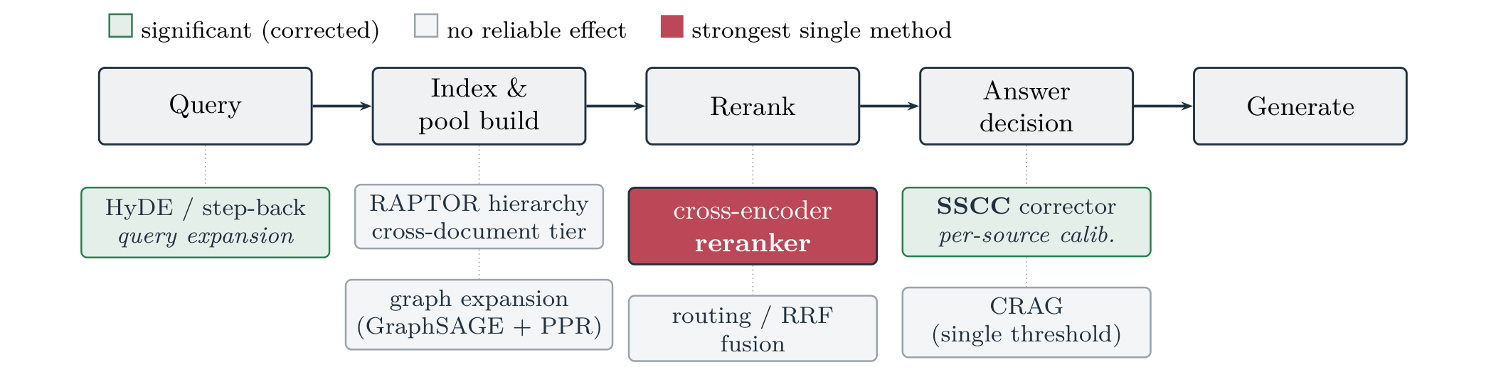
WHERE WE ARE
Session 33 built the pipeline
Source: Singh, Allam Reddy & Chopra (2026), "Beyond the Reranker", arXiv:2606.28367, Fig. 1. Reproduced with attribution.
What you already own
What today adds
Chunking, indexing, dense retrieval, BM25 + RRF,
cross-encoder reranking, grounded prompting, and a
hit-rate / MRR harness to score all of it.
Four techniques that live at the query stage and the
pool-build stage — the two boxes on the left of that
diagram. Green = reliable gain, grey = no effect.
Session 34a · Advanced RAG

Slide 4
THE PROBLEM
Question and answer are written differently
Vocabulary mismatch
Length and shape asymmetry
The user writes "why did margins drop?"
The document says "gross profit contracted 340 bps
on input-cost inflation."
Not one word in common: BM25 scores this near zero.
A query is 6–12 tokens. A chunk is 300–500.
The encoder was trained mostly on document-like
text, so a short interrogative sits in a thinly
populated region. You compare a fragment to a
paragraph and hope the geometry cooperates.
The insight both HyDE and multi-query exploit
Nothing forces you to search with the string the user typed. The query is just a vector, and you control
how that vector is produced — rewrite it, expand it, invent a document for it, or issue several queries
and merge the results. None of this touches the index, which is why each is cheap to try and to remove.
Session 34a · Advanced RAG

Slide 5
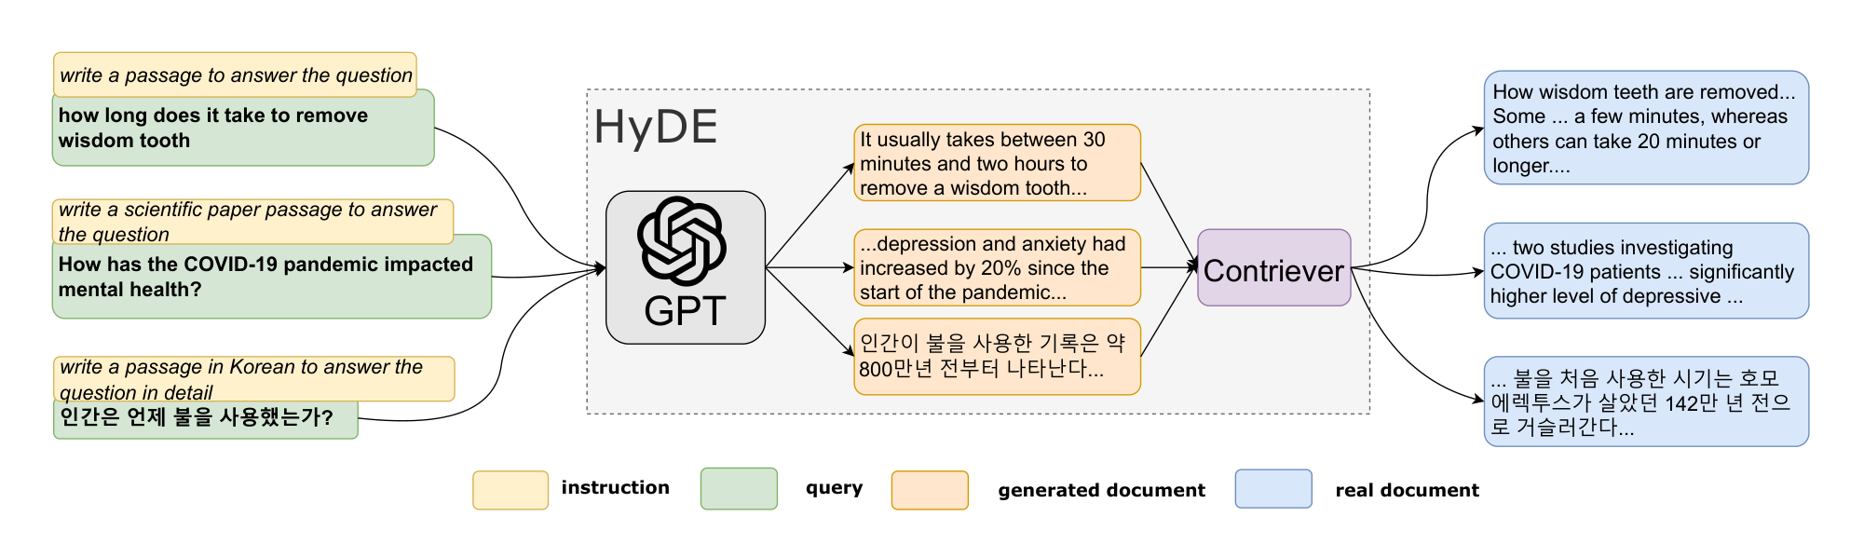
HYDE · THE IDEA
Invent the answer, then go find the real one
Why this works
A hypothetical answer is document-
shaped: it has the vocabulary and the
register of the thing you want.
So instead of question-to-document
you get a document-to-document
comparison — the one the encoder is
actually good at.
The hypothesis may be wrong; it is
discarded after embedding.
Source: Gao, Ma, Lin & Callan (2022), arXiv:2212.10496, Figure 1 (ACL 2023). Reproduced with attribution.
The trick: the fake document is a search key, not an answer. Its job is to land in the right neighbourhood.
Session 34a · Advanced RAG

Slide 6
HYDE · MECHANICS
Five steps, one extra LLM call
1 · Query
the user's question
2 · Generate
LLM writes a hypothetical passage
3 · Embed
embed the passage, not the question
4 · Search
nearest neighbours in the real index
5 · Generate
answer from real chunks only
The prompt that does the work
Three implementation details
"Write a short passage from a technical document
that would answer this question. Do not hedge and
do not say it is hypothetical. Question: {q}"
Match the instruction to your corpus: a paper
passage, a support ticket, a contract clause.
• Generate 3–8 hypotheses and average their
embeddings — averaging cancels hallucinations.
• Include the raw query vector in that average.
• Cap generation at about 120 tokens.
Cost: one extra generation per query — roughly 1–5 s of latency, or +25–60 % end to end on small models.
Session 34a · Advanced RAG

Slide 7
HYDE · EVIDENCE AND LIMITS
The query-side method that survives ablation
Evidence
What was measured
Result
Gao et al., ACL 2023
11 query sets: web search, QA, fact verification; EN, SW, KO, JA
Beats unsupervised SOTA (Contriever); comparable to fine-tuned retrievers
Cascade Research, 2026
Ablation on HetDocQA (n = 363), full pipeline with a cross-encoder reranker
Removing HyDE costs 6.7 F1 (0.548 → 0.481), p < .001
T2-RAGBench (financial)
Numerical questions over filings
HyDE consistently underperforms plain dense retrieval
Where it fails
When to reach for it
Exact strings, IDs, dates and figures — the
hypothesis invents plausible ones. Multi-part or
heavily constrained questions go generic.
Conceptual questions over prose. Domains where
users and documents speak differently. Zero-shot
settings with no labels to fine-tune a retriever.
Session 34a · Advanced RAG

Slide 8
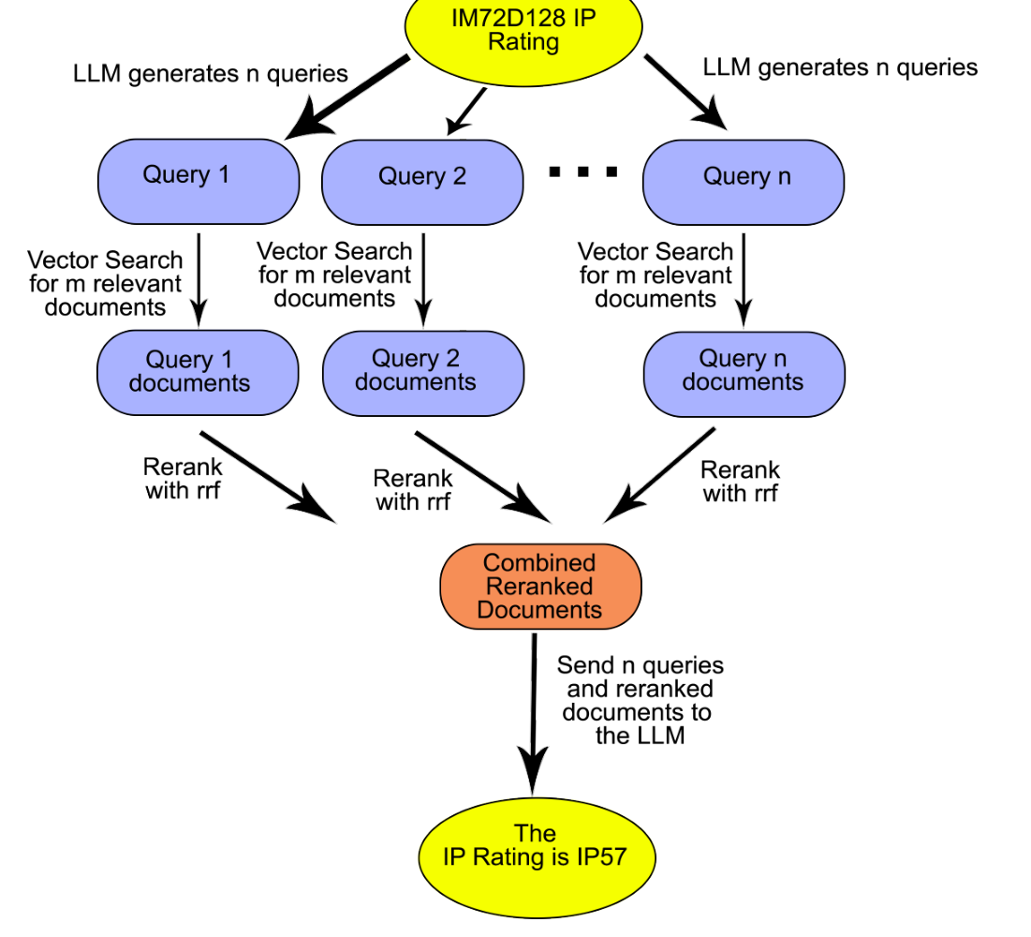
MULTI-QUERY RETRIEVAL · THE IDEA
One question, several phrasings, one ranking
What the LLM is asked to do
"Generate 4 alternative versions of this question that a user might
have typed, covering different vocabulary and specificity."
"How do I reduce inference cost?" becomes quantisation · batching ·
smaller models · caching — four neighbourhoods of the index.
Why merging matters more than expanding
A chunk near the top of several lists is far more likely to be relevant
than one that tops a single list. That agreement is the entire signal —
and Reciprocal Rank Fusion turns it into one line: 1 / (60 + rank).
Source: Rackauckas (2024), arXiv:2402.03367, Fig. 1.
Session 34a · Advanced RAG

Slide 9
MULTI-QUERY RETRIEVAL · MECHANICS
A recall play, not a precision play
The loop
What it costs you
1. One LLM call generates N variants (N = 3–5).
2. Retrieve top-k for each variant, in parallel.
3. Fuse the N ranked lists with RRF.
4. Deduplicate — chunks repeat across lists.
5. Rerank, then take the top 4–6 into the prompt.
• One extra LLM call, ~0.5–1.5 s, up front.
• N× the vector searches — cheap on FAISS, a real
line item on a hosted DB billed per query.
• A larger pool, so the reranker works harder.
• Latency the user feels: none of it streams.
Failure mode
What happens
Mitigation
Drift
A variant quietly changes the question and drags in off-topic chunks
Log the variants; cap N at 4; always keep the original query as one of the N
Dilution
Genuinely narrow questions get padded with broader neighbours
Route: expand only when the first-pass top score is below a threshold
Session 34a · Advanced RAG

Slide 10
CHOOSING BETWEEN THEM
They fix different things, and they compose
HyDE
Multi-query
What it changes
The shape of the query vector — makes it document-like
The number of query vectors — covers several intents
Which metric moves
Precision at the top. Better alignment, same pool size
Recall. A bigger, more diverse pool
Best on
Conceptual questions in a domain with its own jargon
Ambiguous or many-faceted questions
Worst on
Numbers, IDs, exact strings
Narrow questions that were already precise
Extra LLM calls
1 (or 3–8 if you average hypotheses)
1
Composable: RAG-Fusion generates N variants and runs HyDE on each. Measure it before you ship it — that is N+1 LLM calls per question.
Session 34a · Advanced RAG

Slide 11
THE CHUNK-SIZE DILEMMA
Search unit and read unit want different sizes
Small chunks retrieve well
Large chunks read well
A 150-token chunk is about one idea, so its
embedding is sharp and the cosine score means
something.
Handed to the LLM alone it is often unusable: the
pronoun has no referent, the number has no unit,
the clause has no contract around it.
A 1,200-token chunk carries its own context. The
model can actually answer from it.
But its embedding is an average of six topics, so it
scores mediocre on everything and wins nothing.
Dilution is a retrieval failure, not a generation
failure — and no prompt fixes it.
Session 33 made you pick one number. This technique says you need not.
Embed the small chunk. Return the large one. The child is the search key; the parent is the payload.
The two are linked by an ID, and that link is the only new machinery involved.
Session 34a · Advanced RAG

Slide 12
PARENT DOCUMENT RETRIEVER · MECHANICS
Search small, read big
AT INDEX TIME
Document
one PDF, page or section
Parent split
800–2,000 tokens kept in a docstore
Child split
150–300 tokens, each with parent_id
Embed children
only children enter the vector index
AT QUERY TIME
Query
embed as usual
Search children
top-k over small, sharp vectors
Look up parents
map child_id → parent_id
Deduplicate
children often share one parent
Prompt
parents go to the LLM
The step everyone forgets: deduplication. Four children of one parent otherwise send the same 2,000 tokens four times.
Session 34a · Advanced RAG

Slide 13
PARENT DOCUMENT RETRIEVER · LIMITS
Three settings of one dial
Variant
What comes back
Use when
Sentence window
The matched sentence ± 2–3 neighbouring sentences
Dense reference text — legal clauses, spec sheets. Cheapest in tokens
Parent chunk
The 800–2,000-token section the child came from
The default. Sections are a real semantic unit in most documents
Full document
The entire source file
Short documents only — tickets, emails, one-page memos
What it costs
What it does not fix
Context. Four parents at 2,000 tokens is 8,000 tokens
of prompt — and "lost in the middle" says the model
may not read the middle of it.
Retrieval quality. Children are still found by the same
model with the same blind spots. The metric this moves
is answer F1, not hit rate.
Session 34a · Advanced RAG

Slide 14
HYBRID SEARCH, DEEPENED
You built it in Session 33. Here is why it works.
BM25 — what it actually computes
Dense — what it trades away
Three ideas, no training, one CPU inverted index:
• IDF — rare terms count more than common ones.
• Saturation (k₁) — the 10th occurrence of a term
adds far less than the 2nd.
• Length normalisation (b) — long documents do
not win on volume alone.
A learned map from meaning to geometry:
• Generalises across paraphrase and language.
• Compresses 400 tokens into 1,536 floats.
• A rare token carrying the whole query (an SKU, an
error code) is a small part of that average.
• Out of domain it degrades quietly, not loudly.
Query
BM25
Dense
Verdict
"error code E-4021"
Exact hit
Near miss
Sparse wins
"why is my build slow?"
Nothing shared
Strong match
Dense wins
"§7.3 termination for cause"
Exact hit
Finds other clauses
Sparse wins
Session 34a · Advanced RAG

Slide 15
LEARNED SPARSE RETRIEVAL
Sparse vectors, with the semantics learned in
Retriever
Type
nDCG@10
SPLADE, in one sentence
BM25
sparse
42.9
A masked language model expands each document
into a sparse vector over the whole vocabulary,
with learned weights.
Index "automobile" and the vector also carries
weight on "car" and "vehicle" — still an inverted
index, but it no longer needs your exact words.
SPLADE
learned sparse
51.3
CSPLADE
learned sparse
54.6
text-embedding-3-large
dense
64.6
Qwen3-Embedding-8B
dense
70.6
BEIR average, from 2026 reproductions and public leaderboards.
Treat the ordering as robust and the exact values as version-dependent.
Why we still teach BM25 first
SPLADE needs a GPU at query time; BM25 needs only an inverted index and stays roughly an order of magnitude faster.
Session 34a · Advanced RAG

Slide 16
FUSING TWO RANKINGS
Why everyone fuses ranks instead of scores
Score fusion — the tempting one
Reciprocal Rank Fusion — the default
α · norm(dense) + (1 − α) · norm(sparse)
BM25 is unbounded and corpus-dependent; cosine
sits in [−1, 1] and, for OpenAI embeddings, in a
narrow band around 0.3–0.5.
Min–max normalising per query makes the scale
depend on what was retrieved, so α needs retuning.
score(d) = Σ 1 / (k + rank(d)), k = 60
Only ranks are used, so nothing needs normalising
and nothing needs tuning. k = 60 comes from
Cormack et al. (2009) and is the default in
Elasticsearch, Weaviate, Qdrant and Azure AI Search.
The same line fuses text and image legs after the break.
Rule of thumb: start with RRF; move to weighted score fusion only when you have a labelled set to tune α on.
Reference point — on WANDS, hybrid reached 0.7497 NDCG vs 0.6983 for BM25 alone and 0.6953 for vector alone.
Session 34a · Advanced RAG

Slide 17
THE HONEST SCOREBOARD
Ablating one method at a time
Configuration
nDCG@10
Answer F1
p
Reliable gain?
Full pipeline
0.644
0.548
—
− cross-encoder reranker
0.034
0.249
< .001
Yes — by an order of magnitude
− HyDE (query expansion)
0.542
0.481
< .001
Yes
− RAPTOR hierarchy
0.650
0.523
.004
Unstable — sign flips on dev
− graph expansion
0.641
0.542
.214
No
− RRF rank fusion
0.644
0.548
1.00
No
Semantic retrieval only
0.288
0.421
< .001
HetDocQA test split, n = 363; each row removes one method from the full pipeline. Singh, Allam Reddy & Chopra (2026), arXiv:2606.28367, Table 2.
Read this carefully. It does not say RRF is useless — it says that once a strong cross-encoder has reordered the pool,
fusing the lists that fed that pool adds nothing measurable. Order of operations decides what still has room to help.
Session 34a · Advanced RAG

Slide 18
WHAT TO ADD, AND IN WHAT ORDER
Diagnose from the symptom, not the blog post
Symptom in your eval
Reach for
Metric it should move
The right chunk is in the top 50 but not the top 5
A cross-encoder reranker — first, always
MRR, then answer F1
The right chunk is never retrieved at all
Hybrid retrieval, then multi-query
Hit rate / recall@k
Users and documents use different vocabulary
HyDE
MRR and answer F1
Retrieval is right, answers are still thin
Parent document retriever
Answer F1 only
Exact IDs, codes and figures are missed
A BM25 leg, or metadata filtering
Hit rate on that query class
The order is not arbitrary: reranking is cheap, local, and by far the largest single effect.
Session 34a · Advanced RAG

Slide 19
RECAP
Six things to remember
1
The query is not sacred.
You control the vector you search with — rewrite it, expand it, or invent a document for it.
2
HyDE changes the shape of the query.
Document-to-document beats question-to-document, until the answer hinges on an exact number.
3
Multi-query changes the number of queries.
A recall play. Merge with RRF and always keep the original query in the set.
4
Parent-document splits search unit from read unit.
Embed the child, return the parent, and deduplicate.
5
Dense and sparse fail in opposite directions.
That is the whole argument for hybrid — and why RRF fuses ranks, not scores.
6
Everything here is a hypothesis until your harness scores it.
One published ablation found four popular techniques did nothing once a reranker was present.
Next: Session 34b — Multimodal RAG. Same pipeline, but the chunks are no longer only text.

